Slide 1
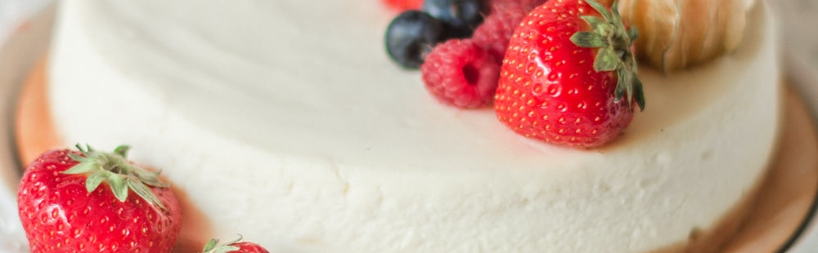
Muhammad Junaid Nazir
200828
BS-CS-B

Slide 2
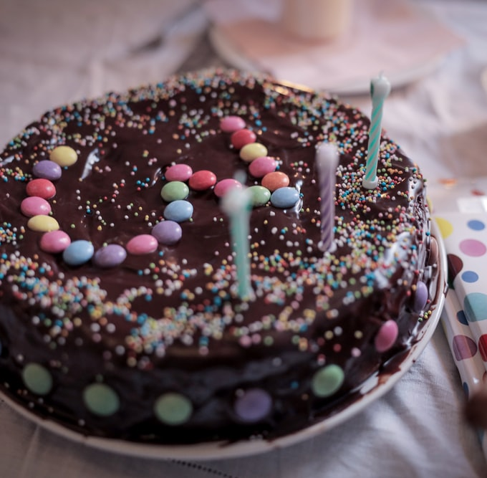
Chocolate Butter Cake
30 minutes • Makes 4 servings
Ingredients
2 eggs
100 g purpose flour
100 g butter
100 g icing sugar
½ tea spoon salt
1 table spoon coco powder
1 tea spoon baking powder
1 Tea spoon vanilla essence
Preparation
Preheat the oven for about 20 min at 180°
Sift together flour, salt, baking powder and coco powder
In separate bowl beat butter and sugar
Add eggs one by one in this mixture; stir and add some drops of vanilla essence
Add the sifted dry materials to the mixture
Pour batter into baking pan
Bake this batter for about 30 min at 180°
Tip: Once the cake mixture is made put it straight into the oven.
Calories 313; total fat 11.99g; saturated fat 5.77g; cholesterol 63mg; sodium 320mg; total carbohydrate 50.05g; dietary fiber 0.7g; protein 2.85g

